Slide 1
Chapter 2
Intelligent Agents

Slide 2
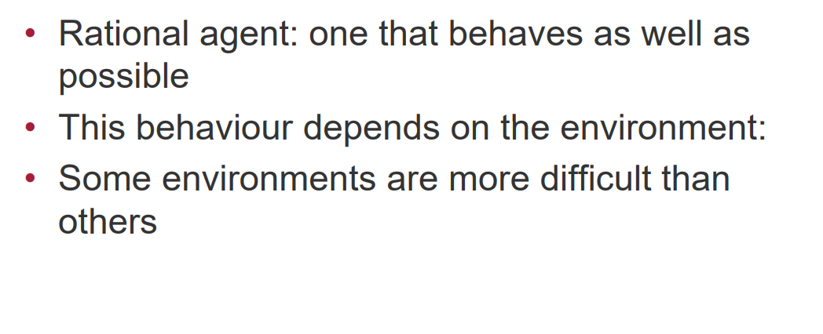

Slide 3
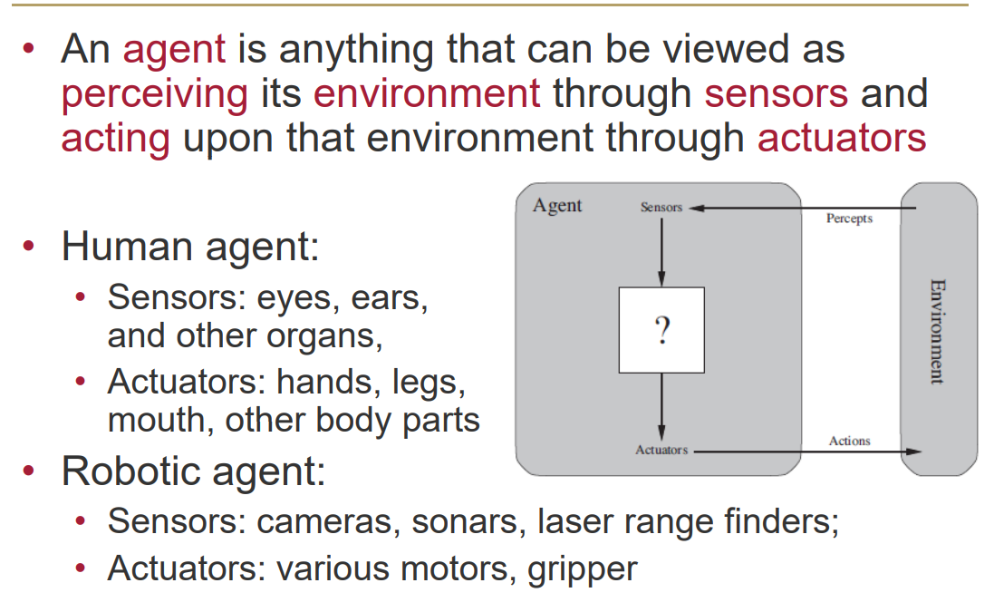
Agents and Environments

Slide 4
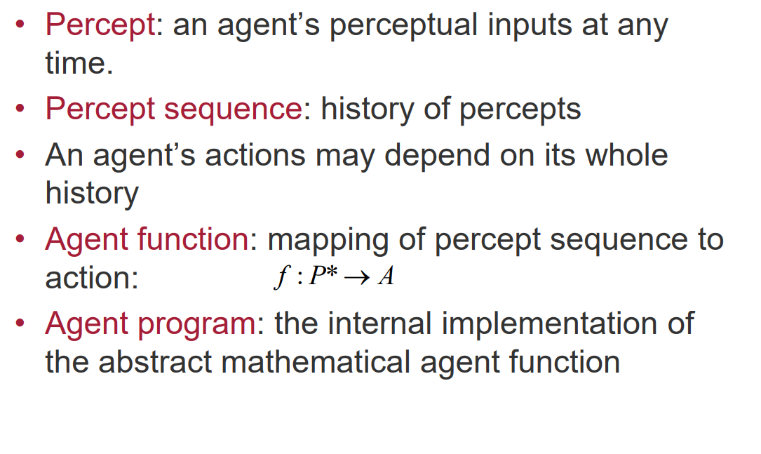

Slide 5
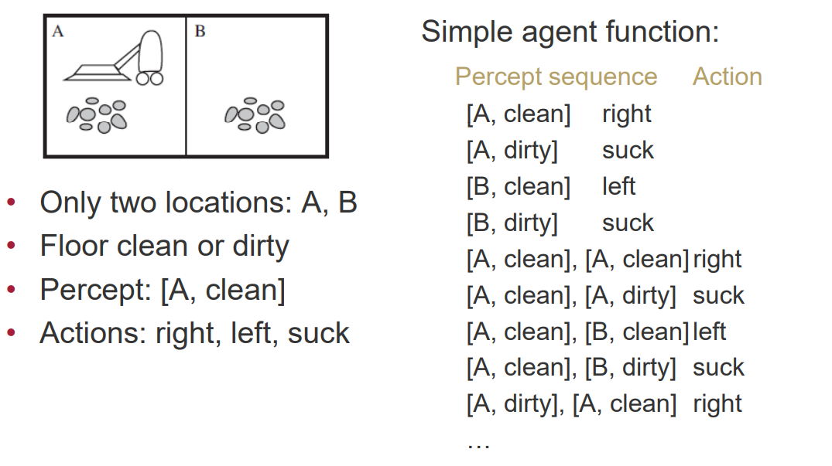
Example – Vaccum Cleaner mini world

Slide 6
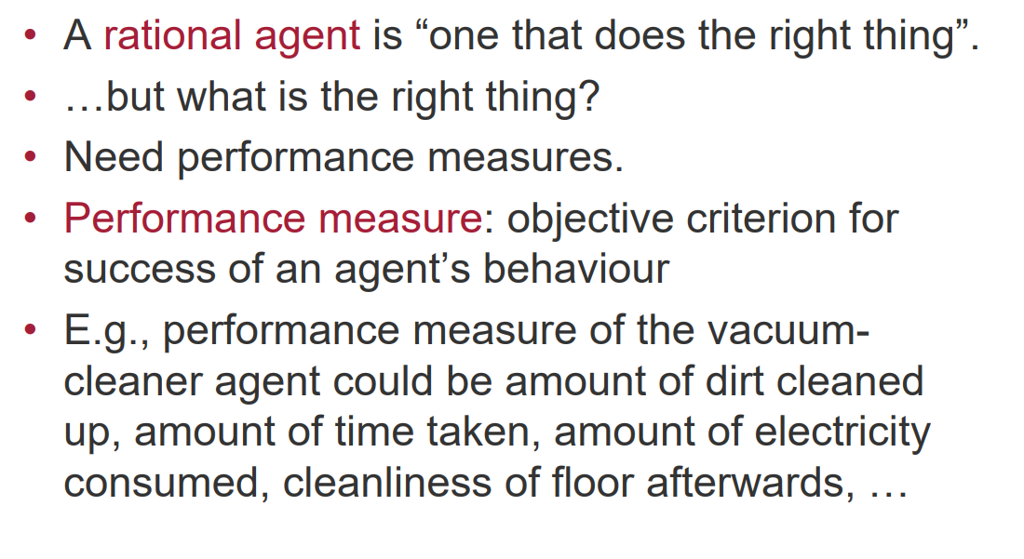
The Concept of Rationality

Slide 7
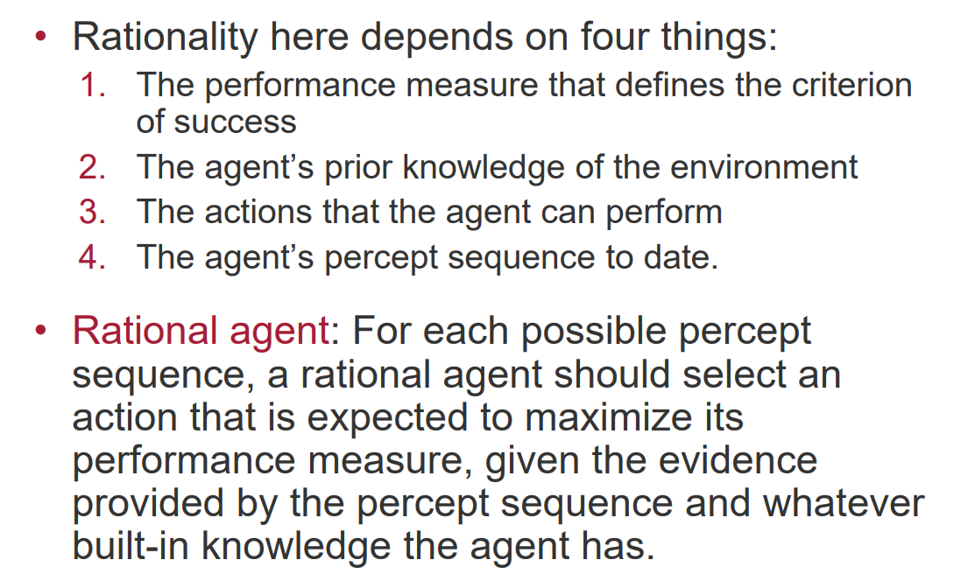

Slide 8
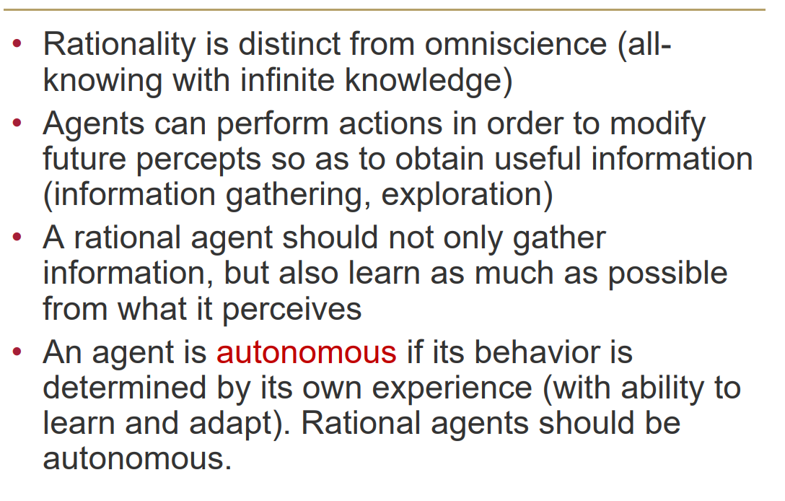
Rationality, Omniscience and Autonomous

Slide 9
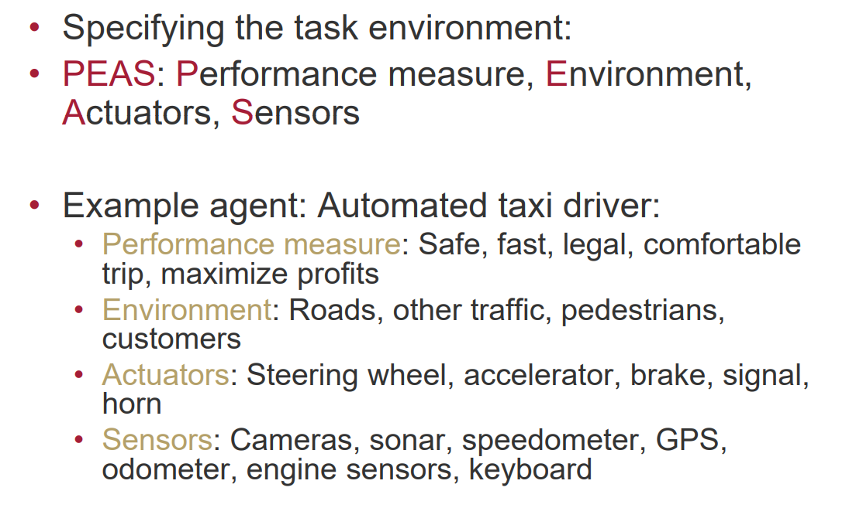
The Nature of Environment

Slide 10
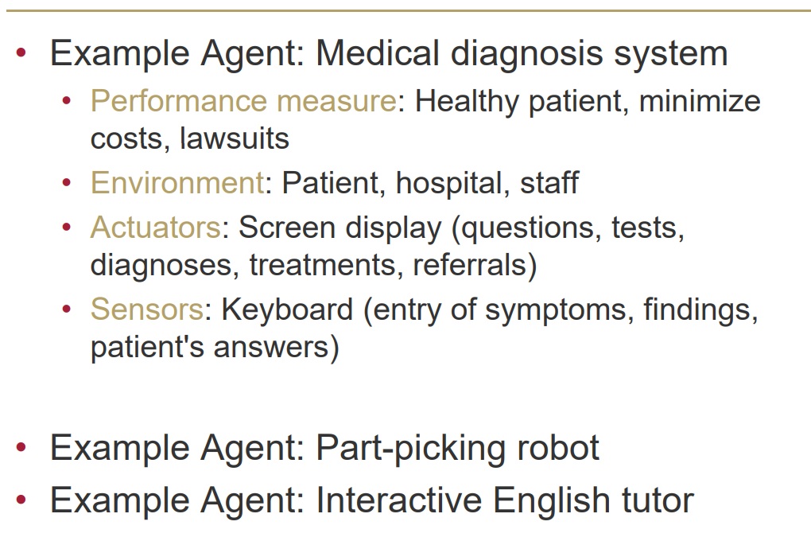
Specifying the Task Environment

Slide 11
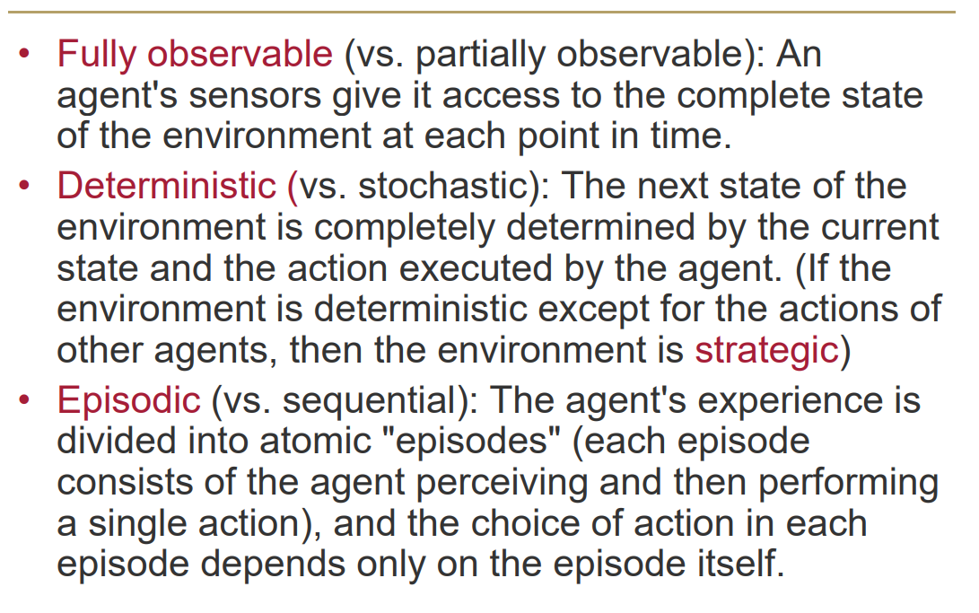
Properties of Task Environments

Slide 12
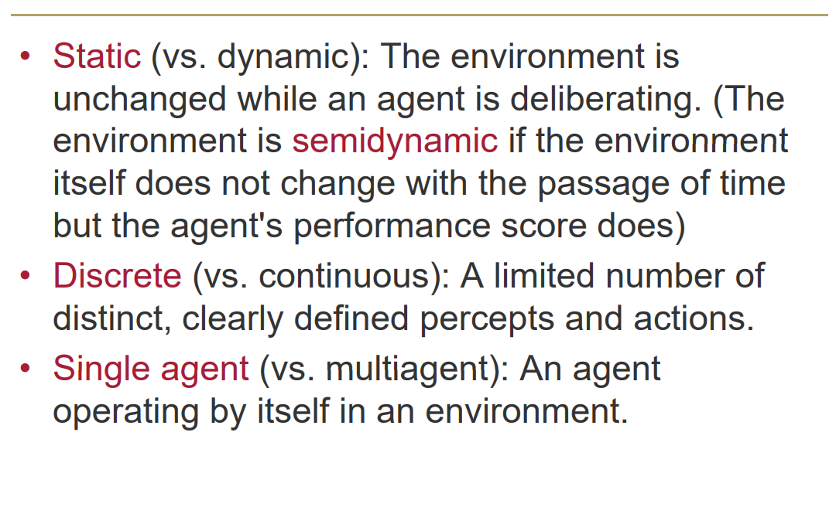

Slide 13
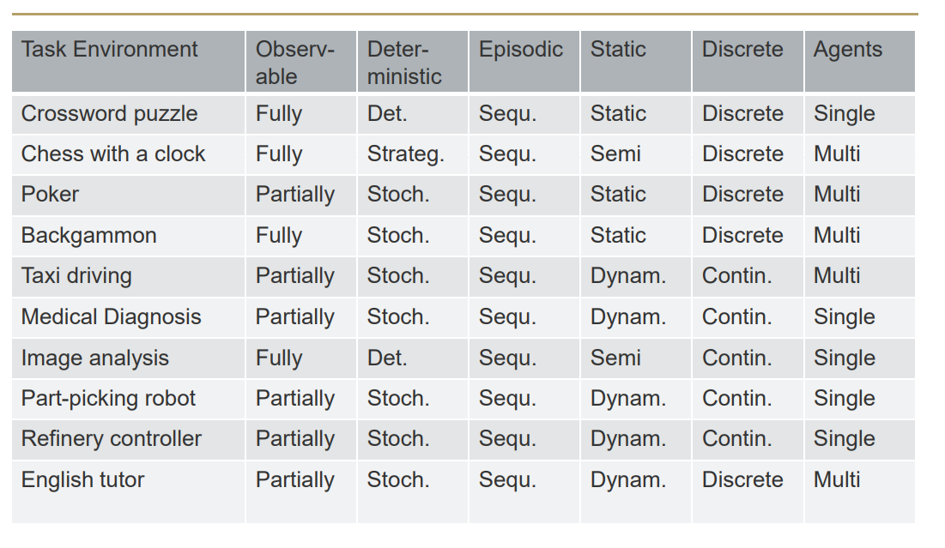
Examples of Task Environments

Slide 14
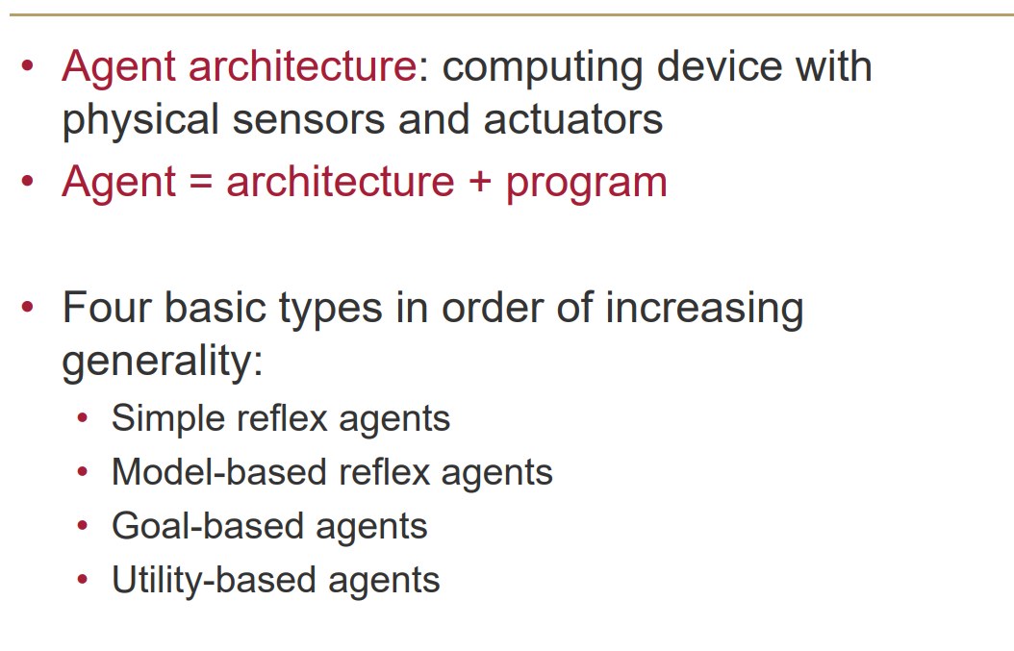
The Structure of Agents

Slide 15
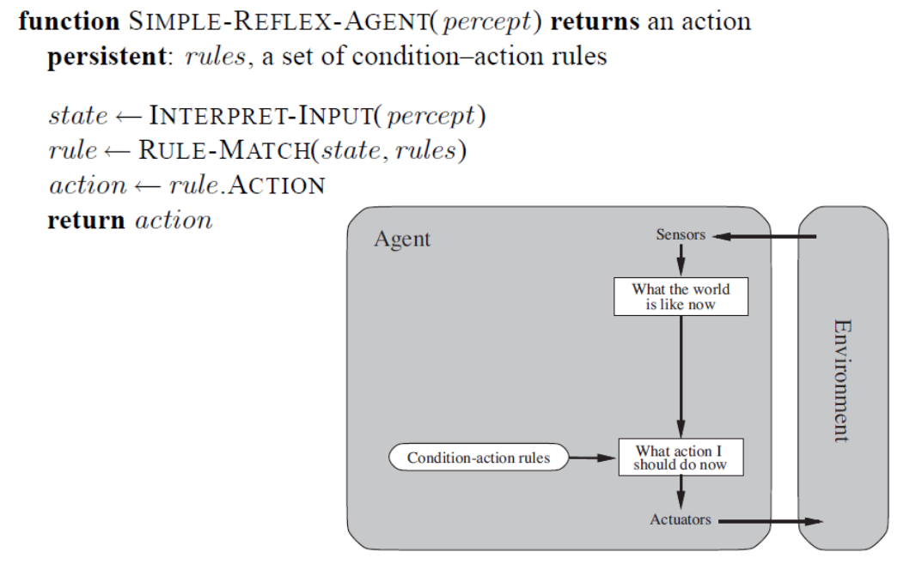
Simple Reflex Agents

Slide 16
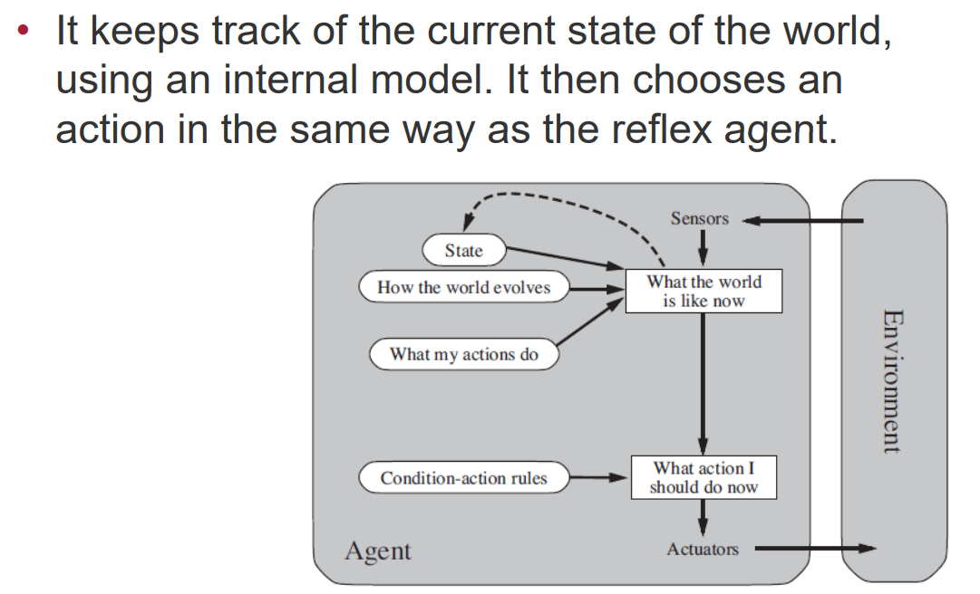
Model Based Reflex Agents

Slide 17
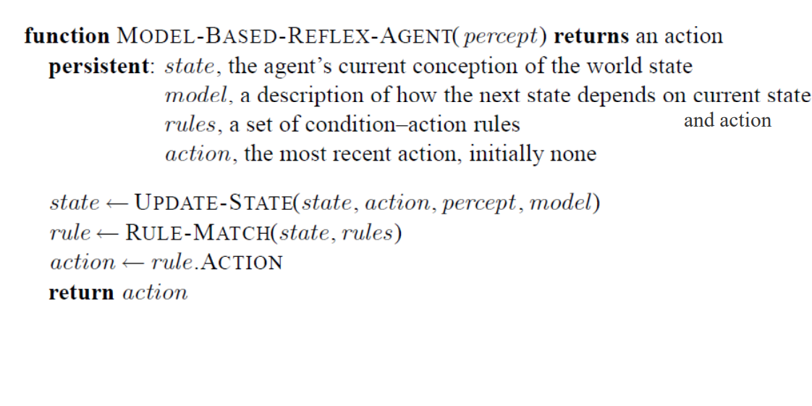
Model Based Reflex Agents

Slide 18
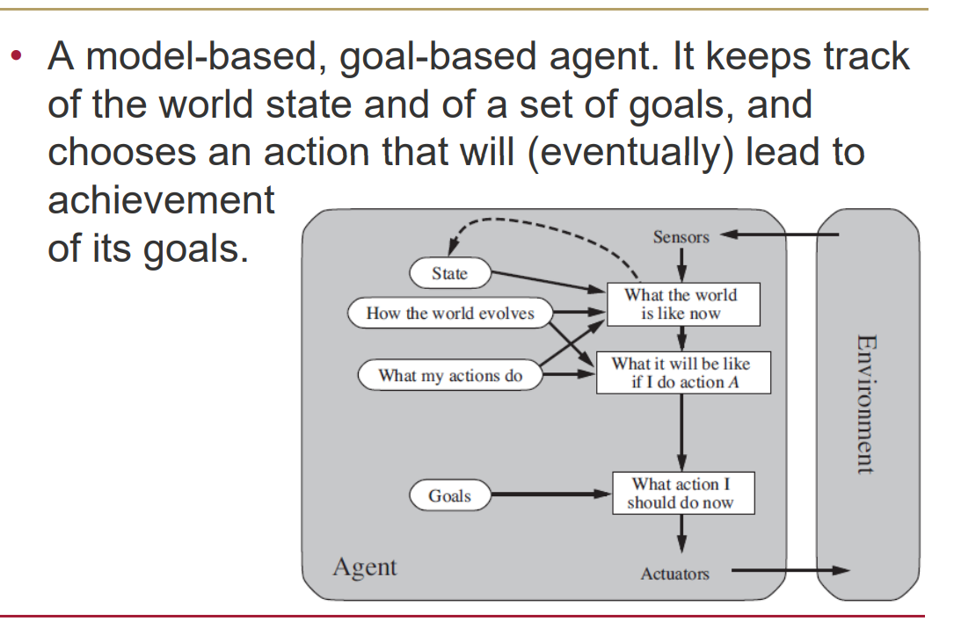
Model-Based, Goal-Based Agents

Slide 19
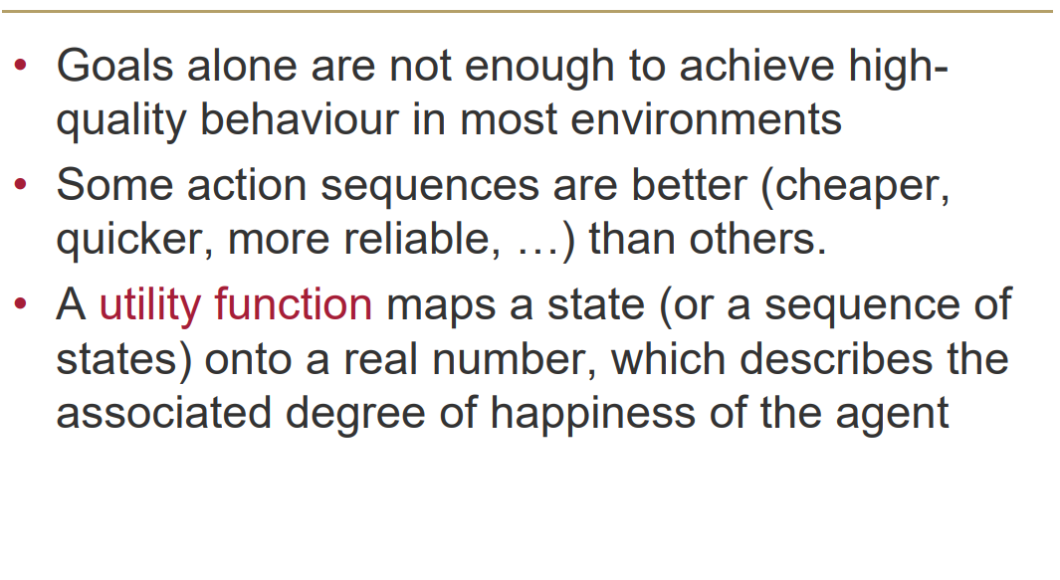
Utility-Based Agents

Slide 20
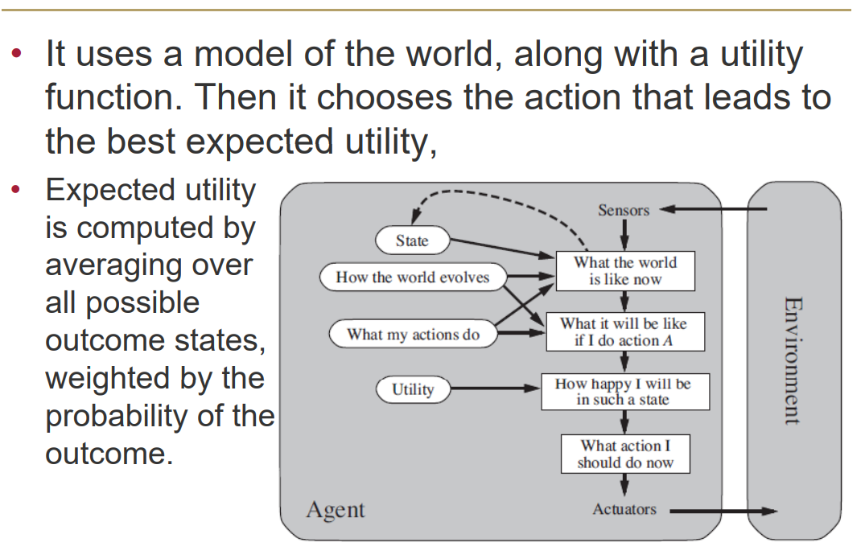
Utility-Based Agents

Slide 21
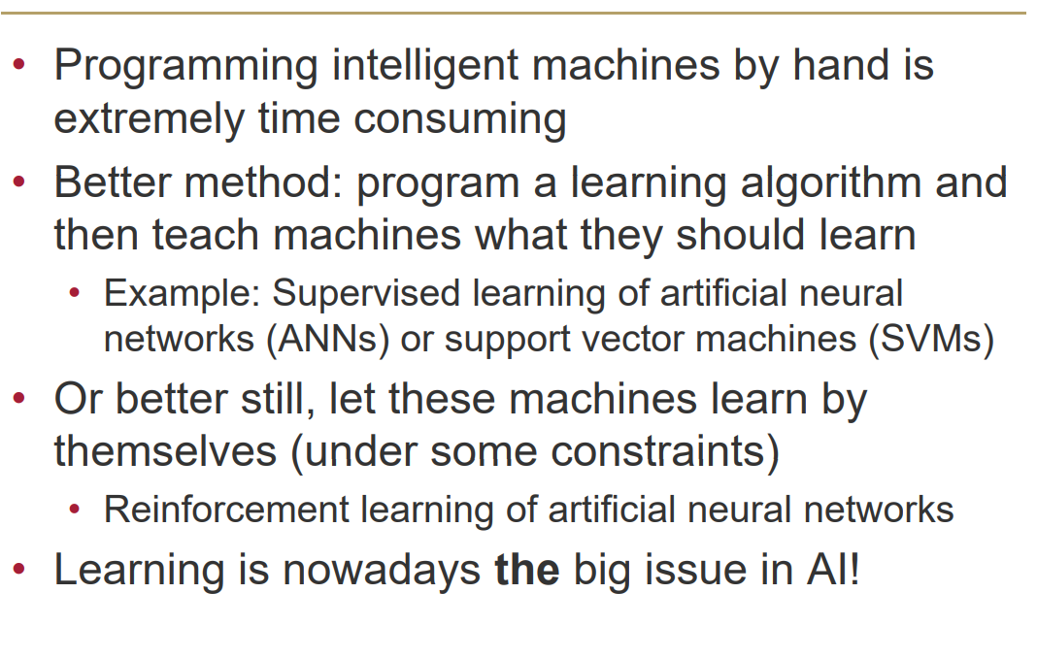
Learning Agents

Slide 22
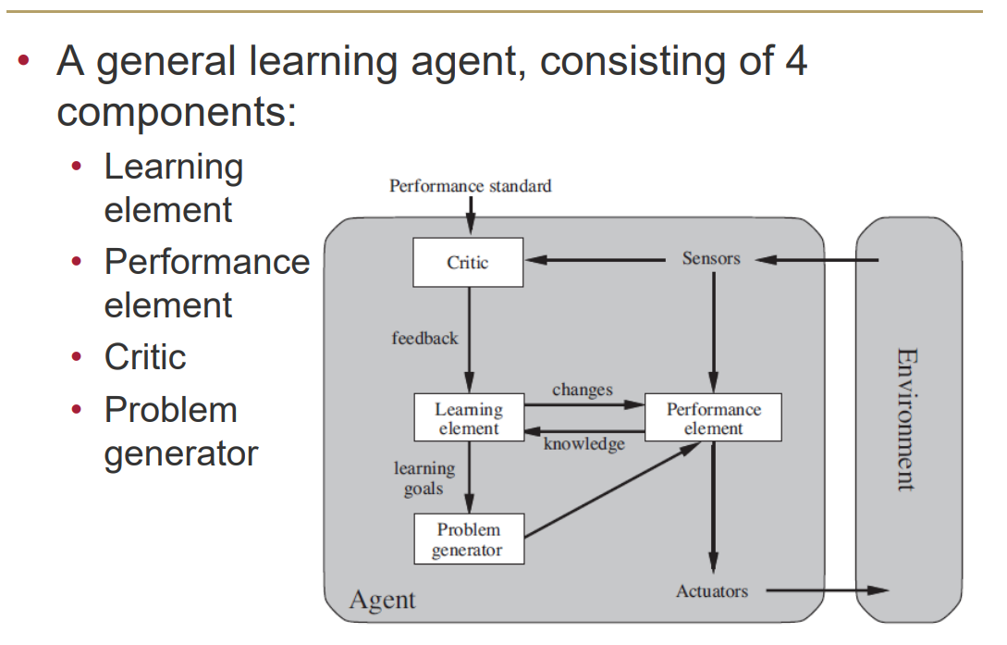
Learning Agents

Slide 23
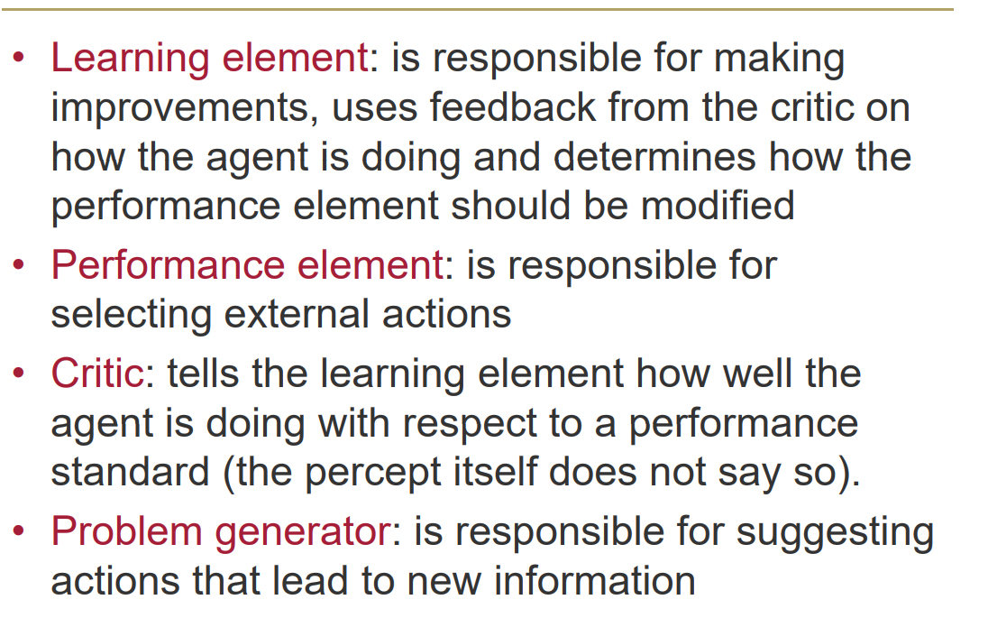
Learning Agents

